Slide 1
Cloud Computing
Introduction to Cloud Computing

Slide 2
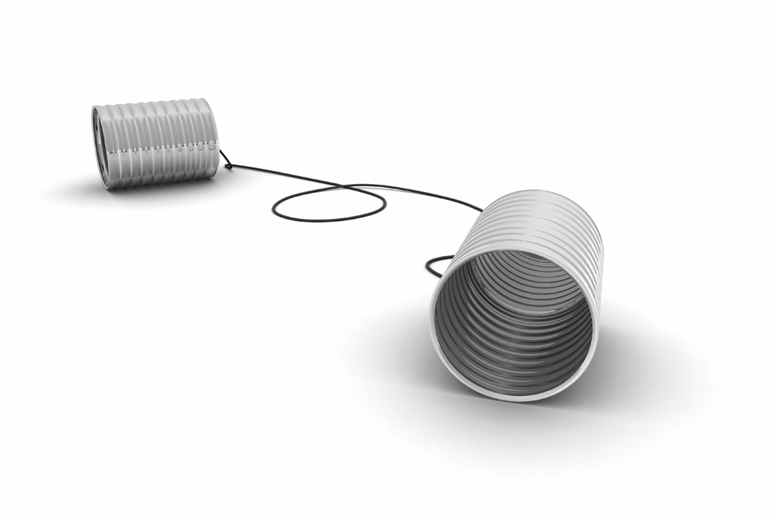
What is Cloud Computing ?

Slide 3

Cloud Definitions
Definition from NIST (National Institute of Standards and Technology)
Cloud computing is a model for enabling convenient, on-demand network access to a shared pool of configurable computing resources (e.g., networks, servers, storage, applications, and services) that can be rapidly provisioned and released with minimal management effort or service provider interaction.
Definition from NIST (National Institute of Standards and Technology)
Cloud computing is a model for enabling convenient, on-demand network access to a shared pool of configurable computing resources (e.g., networks, servers, storage, applications, and services) that can be rapidly provisioned and released with minimal management effort or service provider interaction.

Slide 4
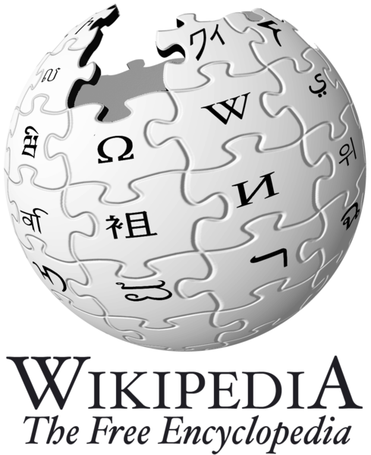
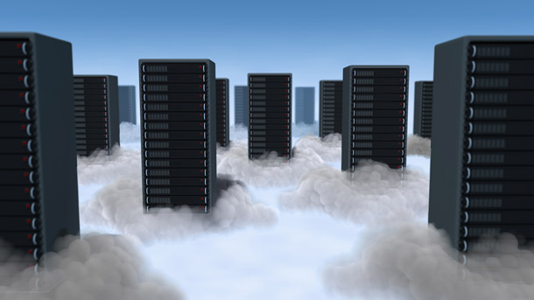
Cloud Definitions
Definition from Wikipedia
Cloud computing is Internet-based computing, whereby shared resources, software, and information are provided to computers and other devices on demand, like the electricity grid.
Cloud computing is a style of computing in which dynamically scalable and often virtualized resources are provided as a service over the Internet.
Definition from Wikipedia
Cloud computing is Internet-based computing, whereby shared resources, software, and information are provided to computers and other devices on demand, like the electricity grid.
Cloud computing is a style of computing in which dynamically scalable and often virtualized resources are provided as a service over the Internet.

Slide 5
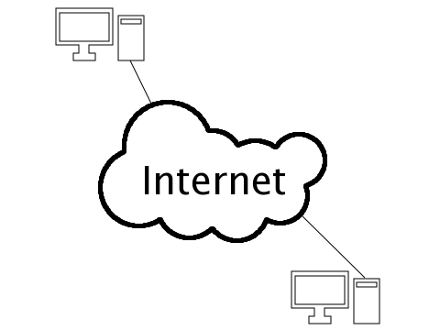
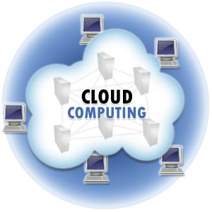
Cloud Definitions
Definition from Whatis.com
The name cloud computing was inspired by the cloud symbol that's often used to represent the Internet in flowcharts and diagrams. Cloud computing is a general term for anything that involves delivering hosted services over the Internet.
Definition from Whatis.com
The name cloud computing was inspired by the cloud symbol that's often used to represent the Internet in flowcharts and diagrams. Cloud computing is a general term for anything that involves delivering hosted services over the Internet.

Slide 6

Cloud Definitions
Definition from Berkeley
Cloud Computing refers to both the applications delivered as services over the Internet and the hardware and systems software in the datacenters that provide those services.
The services themselves have long been referred to as Software as a Service (SaaS), so we use that term. The datacenter hardware and software is what we will call a Cloud.
When a Cloud is made available in a pay-as-you-go manner to the public…… The service being sold is Utility Computing.
Definition from Berkeley
Cloud Computing refers to both the applications delivered as services over the Internet and the hardware and systems software in the datacenters that provide those services.
The services themselves have long been referred to as Software as a Service (SaaS), so we use that term. The datacenter hardware and software is what we will call a Cloud.
When a Cloud is made available in a pay-as-you-go manner to the public…… The service being sold is Utility Computing.

Slide 7
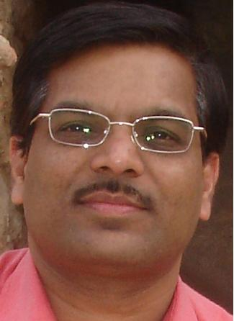
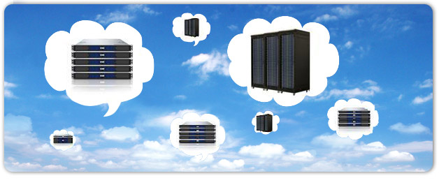
Cloud Definitions
Definition from Buyya
A Cloud is a type of parallel and distributed system consisting of a collection of interconnected and virtualized computers that are dynamically provisioned and presented as one or more unified computing resources based on service-level agreements established through negotiation between the service provider and consumers.
Definition from Buyya
A Cloud is a type of parallel and distributed system consisting of a collection of interconnected and virtualized computers that are dynamically provisioned and presented as one or more unified computing resources based on service-level agreements established through negotiation between the service provider and consumers.

Slide 8
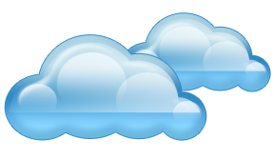
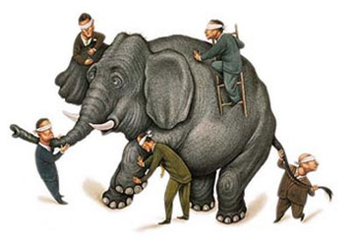
Properties and characteristics

Slide 9
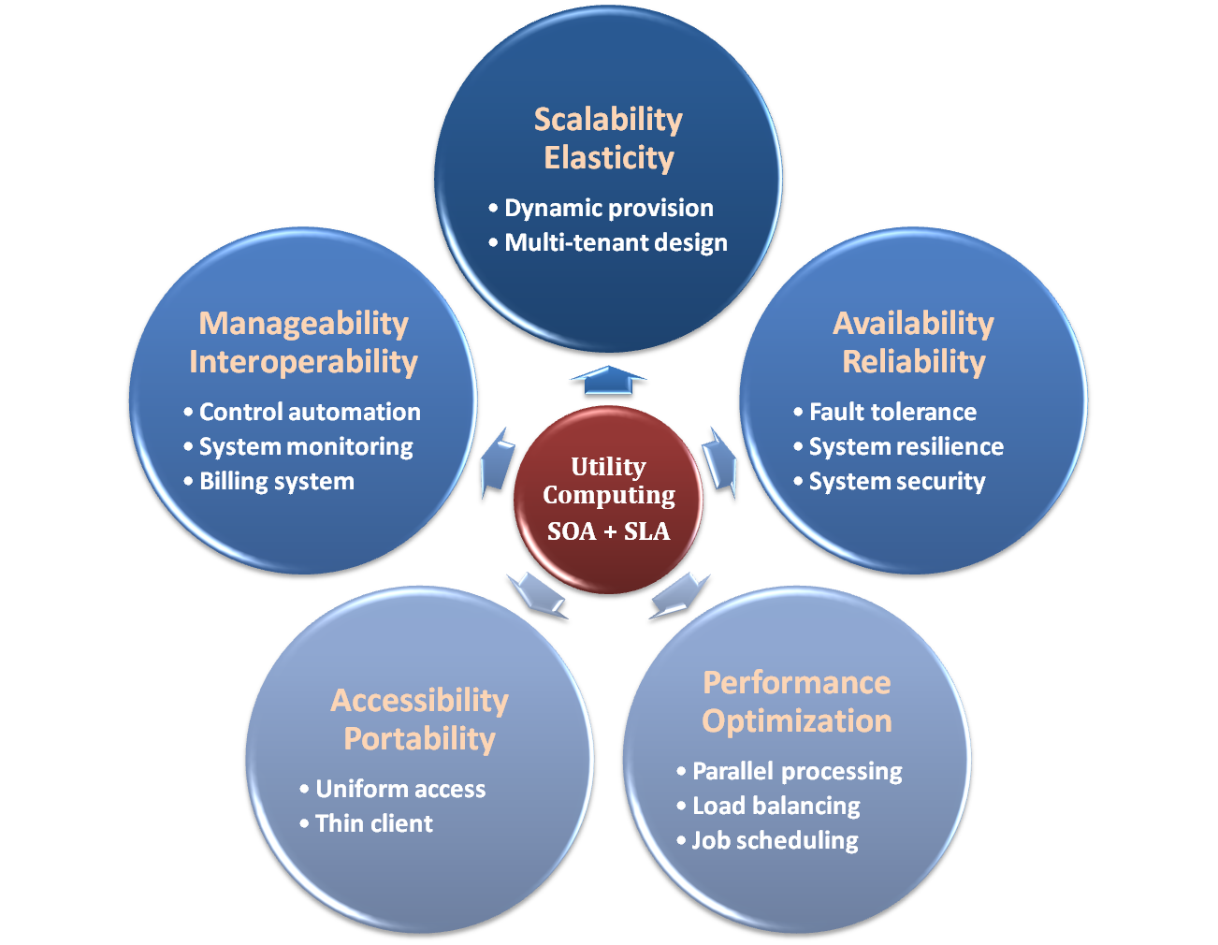
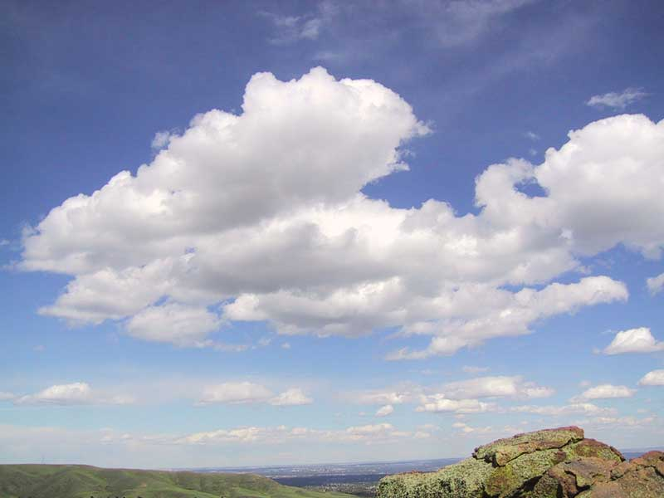
Properties and Characteristics

Slide 10
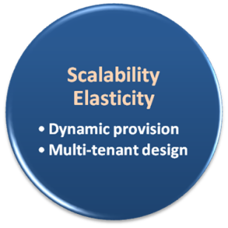
Scalability & Elasticity
What is scalability ?
A desirable property of a system, a network, or a process, which indicates its ability to either handle growing amounts of work in a graceful manner or to be readily enlarged.
What is elasticity ?
The ability to apply a quantifiable methodology that allows for the basis of an adaptive introspection with in a real time infrastructure.
But how to achieve these properties ?
Dynamic provisioning
Multi-tenant design

Slide 11
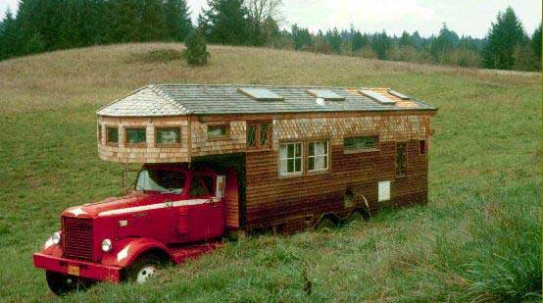
Dynamic Provisioning
What is dynamic provisioning ?
Dynamic Provisioning is a simplified way to explain a complex networked server computing environment where server computing instances are provisioned or deployed from a administrative console or client application by the server administrator, network administrator, or any other enabled user.

Slide 12
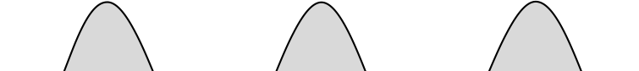
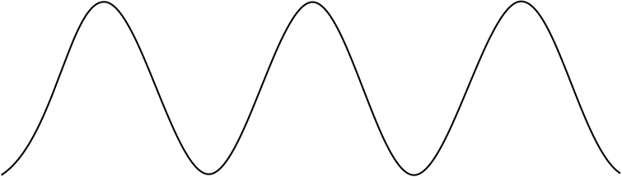
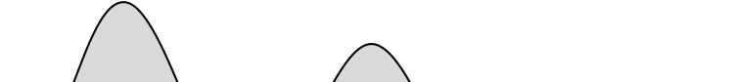

Dynamic Provisioning
In traditional computing model, two common problems :
Underestimate system utilization which result in under provision
Loss Revenue
Resources
Capacity
Resources
Demand
Capacity
1
2
3
Demand
Loss Users
Resources
Capacity
1
2
3
Time (days)
Demand
1
2
3

Slide 13
Dynamic Provisioning
Overestimate system utilization which result in low utilization
How to solve this problem ??
Dynamically provision resources
Capacity
Resources
Unused resources
Demand
Time

Slide 14
Dynamic Provisioning
Cloud resources should be provisioned dynamically
Meet seasonal demand variations
Meet demand variations between different industries
Meet burst demand for some extraordinary events
Resources
Capacity
Resources
Capacity
Demand
Demand
Time
Time

Slide 15
Multi-tenant Design
What is multi-tenant design ?
Multi-tenant refers to a principle in software architecture where a single instance of the software runs on a server, serving multiple client organizations.
With a multi-tenant architecture, a software application is designed to virtually partition its data and configuration thus each client organization works with a customized virtual application instance.
Client oriented requirements :
Customization
Multi-tenant applications are typically required to provide a high degree of customization to support each target organization's needs.
Quality of service
Multi-tenant applications are expected to provide adequate levels of security and robustness.

Slide 16
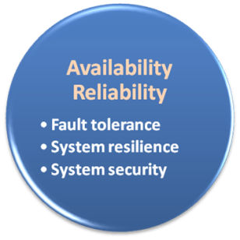
Availability & Reliability
What is availability ?
The degree to which a system, subsystem, or equipment is in a specified operable and committable state at the start of a mission, when the mission is called for at an unknown time.
Cloud system usually require high availability
Ex. “Five Nines” system would statistically provide 99.999% availability
What is reliability ?
The ability of a system or component to perform its required functions under stated conditions for a specified period of time.
But how to achieve these properties ?
Fault tolerance system
Require system resilience
Reliable system security

Slide 17
Fault Tolerance
What is fault tolerant system ?
Fault-tolerance is the property that enables a system to continue operating properly in the event of the failure of some of its components.
If its operating quality decreases at all, the decrease is proportional to the severity of the failure, as compared to a naively-designed system in which even a small failure can cause total breakdown.
Four basic characteristics :
No single point of failure
Fault detection and isolation to the failing component
Fault containment to prevent propagation of the failure

Slide 18

Fault Tolerance
Single Point Of Failure (SPOF)
A part of a system which, if it fails, will stop the entire system from working.
The assessment of a potentially single location of failure identifies the critical components of a complex system that would provoke a total systems failure in case of malfunction.
Preventing single point of failure
If a system experiences a failure, it must continue to operate without interruption during the repair process.

Slide 19

Fault Tolerance
Fault Detection and Isolation (FDI)
A subfield of control engineering which concerns itself with monitoring a system, identifying when a fault has occurred and pinpoint the type of fault and its location.
Isolate failing component
When a failure occurs, the system must be able to isolate the failure to the offending component.

Slide 20
Fault Tolerance
Fault Containment
Some failure mechanisms can cause a system to fail by propagating the failure to the rest of the system.
Mechanisms that isolate a transmitter or failing component to protect the system are required.

Slide 21
System Resilience
What is resilience ?
Resilience is the ability to provide and maintain an acceptable level of service in the face of faults and challenges to normal operation.
Resiliency pertains to the system's ability to return to its original state after encountering trouble. In other words, if a risk event knocks a system offline, a highly resilient system will return back to work and function as planned as soon as possible.
Some risk events
If power is lost at a plant for two days, can our system recover ?
If a key service is lost because a database corruption, can the business recover ?

Slide 22
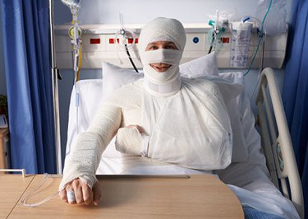
System Resilience
Disaster Recovery
Disaster recovery is the process, policies and procedures related to preparing for recovery or continuation of technology infrastructure critical to an organization after a natural or human-induced disaster.
Some common strategies :
Backup
Make data off-site at regular interval
Replicate data to an off-site location
Replicate whole system
Preparing
Local mirror systems
Uninterruptible Power Supply (UPS)

Slide 23
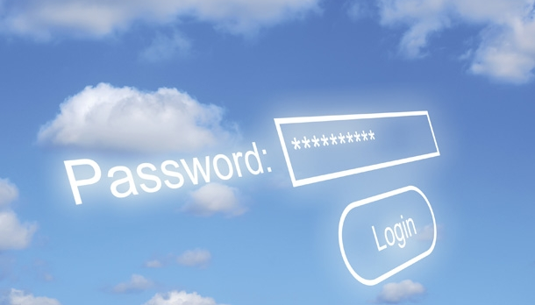
System Security
Security issue in Cloud Computing :
Cloud security is an evolving sub-domain of computer security, network security, and, more broadly, information security.
It refers to a broad set of policies, technologies, and controls deployed to protect data, applications, and the associated infrastructure of cloud computing.

Slide 24
System Security
Important security and privacy issues :
Data Protection
To be considered protected, data from one customer must be properly segregated from that of another.
Identity Management
Every enterprise will have its own identity management system to control access to information and computing resources.
Application Security
Cloud providers should ensure that applications available as a service via the cloud are secure.
Privacy
Providers ensure that all critical data are masked and that only authorized users have access to data in its entirety.

Slide 25
References
NIST (National Institute of Standards and Technology). http://csrc.nist.gov/groups/SNS/cloud-computing/
M. Armbrust et. al., “Above the Clouds: A Berkeley View of Cloud Computing,” Technical Report No. UCB/EECS-2009-28, University of California at Berkeley, 2009.
R. Buyya et. al., “Cloud computing and emerging IT platforms: Vision, hype, and reality for delivering computing as the 5th utility,” Future Generation Computer Systems, 2009.
Cloud Computing Use Cases. http://groups.google.com/group/cloud-computing-use-cases
Cloud Computing Explained. http://www.andyharjanto.com/2009/11/wanted-cloud-computing-explained-in.html
From Wikipedia, the free encyclopedia
All resources of the materials and pictures were partially retrieved from the Internet.

